Slide 1
Software Quality Assurance and Testing Technology
1st Semester, Fall 2022
Xiaoping CHE (xpche@bjtu.edu.cn)
Associate Professor
School of Software Engineering
Beijing Jiaotong University

Slide 2
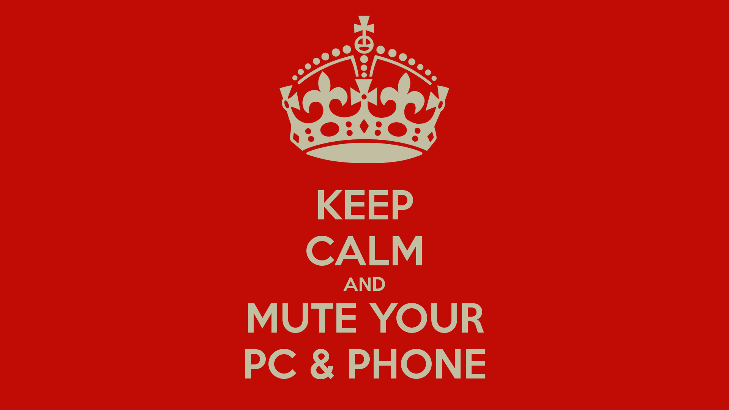



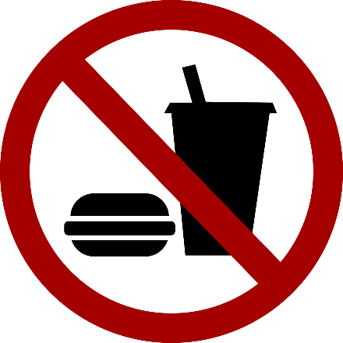
Rules

Slide 3
Rules
Project 20%
Assignments 40%
Final Exam 40%

Slide 4
How
16 Weeks Plan
Week 1: The basic concepts and theories of testing
Week 2-3: Principles of Testing
Week 4-5: White Box Testing
Week 6-7: Test Cases & Black Box Testing
Week 8: Usability Testing
Week 9: Mutation Testing & Finite Automata
Week 10: Mid-term Review and System Testing

Slide 5

How
References
Ron Patton, Software Testing (2th Edition)
Glenford J. Myers, The Art of Software Testing (3rd Edition)
Gerald M. Weinberg, Perfect Software

Slide 6
Review
Input Domain Testing Techniques
Code-Based Testing Techniques
Fault-Based Testing Techniques
Model-Based Testing Techniques

Slide 7
Review
Unit Testing
Integration Testing
System Testing

Slide 8
System Testing
System Testing
Example: Website Testing

Slide 9
System Testing
How to test a website
Easiest way to start is by treating the web site as a black box.
Look at a sample website such as www.apple.com to get a sense of the scale of such an endeavor.
Treat each page as a state with hyperlinks as state transitions.

Slide 10
System Testing
Website text
Web page text should be treated like documentation and tested using the techniques we described previously.
Check for …
correctness of contact information e.g., phone numbers, addresses
correctness of dates and copyright notices
title bar text, bookmark text on browser’s favorites
correctness of the ALT text (i.e., mouse over text)
layout issues when browser window is resized

Slide 11
System Testing
Website hyperlinks
Each link should be checked to make sure it jumps to the correct destination or website.
Ensure that hyperlinks are obvious:
E.g., underlined text, mouse pointer changes
If the link opens an e-mail message, test it
Send an e-mail and verify that you get a response.
Check for orphan pages that are part of the website but cannot be accesses through a hyperlink.
Someone forgot to create the link
Might be intentional … Google will find it, though

Slide 12
System Testing
Website graphics
Do all graphics load and display properly?
Is a graphic missing or incorrectly named?
Does the website intermix text and graphics?
Does the text wrap around the graphics?
What happens when the browser window is re-sized?
Does the page load fast enough?
Are there too many graphics?
Did you try to test the website on a dialup connection instead of a high-speed LAN?

Slide 13
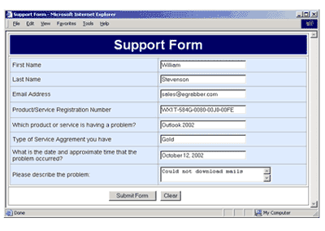
System Testing
Website forms
Forms are the text boxes, list boxes, and other fields for entering and selecting information on the web page.
Are the form fields positioned properly?
Are the fields the correct size?
Do they accept correct data?
Do they reject bad data?
Are optional fields really optional?
A favorite entry point for buffer overflow attacks (more on this later).

Slide 14
System Testing
“Grey-box” testing
A mixture of white-box and black-box testing.
You stick to black-box testing primarily and supplement it by taking a peek at the HTML to figure out how the website works.
For website testing it is worth looking at the HTML code.
It’s there, easy to look at, why not?
Not looking at the HTML code is wasteful, especially since HTML is such a simple language.
HTML is a tagging language for text and graphics.
To create dynamic web content requires that HTML be supplemented by programming code (e.g., Java applets, ActiveX, VBScript, CGI, Perl).

Slide 15
System Testing
White-box testing
To make sure you find the important bugs you should have some knowledge of the website’s programming:
Dynamic content
Database-driven web pages
Programmatically created web pages
Server performance and loading and security

Slide 16
Dynamic content
Dynamic content is graphics and text that changes based on certain conditions.
E.g., time of day, weather, stock tickers
Client-side programming involve embedding scripting code (e.g., JavaScript) into HTML.
Less efficient if the computations are expensive
Code is local, easy to access for testing
Server-side programming is code located on the server.
More efficient for intensive calculations
Requires access to the web server to view the code (might be a problem for testing).

Slide 17
Database-driven web pages
Most E-commerce that show catalogs or inventories are database driven.
E.g., Amazon
Data is pulled from the database, formatted into HTML and sent to the web browser for viewing A three tier architecture is used:
Tier 1: web browsers (presentation)
Tier 2: web page formatter (converts data from Tier 3 to HTML)
Tier 3: database (queried by Tier 2)

Slide 18
Programmatically- Created web pages
HTML or code is generated by a program.
E.g., a web designer may drag and drop elements in a layout program, press a button, and get an HTML page.
Compilers do this all the time, except they translate high-level language code (Java source code) into low-level code that can be executed natively or on a VM (e.g., byte code).
Testing these systems is like testing a compiler …
Automation? (Selenium) (Video)

Slide 19
System Testing
Server performance loading and security
Popular websites can receive millions of hits per day.
www.youtube.com hits 100 Million Videos per day
Each hit requires a download of data from the website’s server to the browser’s computer.
You need to simulate millions of connections and downloads to test a system for performance and loading.
Security issues include:
Denial of service attacks
Buffer overflow attacks

Slide 20
Configuration and compatibility testing
Hardware platform
Mac, PC, PDA, WiFi wristwatch?
Browser software version
Firefox 1.0, IE 6.0, Pocket IE, Netscape 7.2, Safari 2.0.4
Browser plug-ins
To play specific types of audio or video files
Browser options
Security options, ALT text, plug-in, pop ups
Video resolution and color depth
640x480, 800x600, 1024x768, 1280x1024, 256 colors, 16 colors
Text size
Small fonts, medium fonts, large fonts
Connection speed
DSL, modems of varying speed.

Slide 21
System Testing
Usability testing: Jacob Nielsen’s top 10 mistakes in web design
Gratuitous use of bleeding-edge technology
Scrolling text, marquees, and constantly running animations
Long scrolling pages
Non-standard link colors
Outdated information (need website maintenance)
Overly long download times (more than 10 sec to load)
Lack of navigation support
Orphan pages
Complex website addresses (URLs)
Using Frames (just open another window …)

Slide 22
System Testing
Website testing tools
Check out www.netmechanic.com
Website testing is very labor-intensive.
Tools that automatically check websites for:
Browser compatibility
Performance problems
Broken hyperlinks
HTML standard adherence
Spelling on text

Slide 23
System Testing
Web applications
Website - requests are navigational requests.
Web Application - requests can affect the state of the business logic on the server.
Client
Browser
A
Web Server
B
Scripts and Application
Server
C
Database
Server
F
E
D
A: Request
B: Request for page generation
C: SQL command
D: Result set
E: Dynamically generated page
F: Response (dynamic | static page)

Slide 24
System Testing
Web application failures
A 2003 study by the Business Internet Group of San Francisco found that:
72% (29/40) leading e-commerce sites, and
68% (28/41) government sites contained Web application failures
25 “technical errors”
E.g., page not found, multiple attempts to subscribe to a service
3 data errors
E.g., page without text, wrong page returned

Slide 25
System Testing
What type of bugs? Study by Kallepalli and Tian [IEEE TSE].
Analyzed the logs of the Web pages of Southern Methodist University for usage and failure information.
Looked at data from 26 consecutive days.
Total number of “hits” 762,971 (~30,000 hits/day)
A “hit” is registered for each Web page if one of the following happens:
The HTML file corresponding to a page is requested.
Any graphics within the HTML page is requested.

Slide 26
Bug types
Permission denied
No such file or directory
Stale NFS handle
Client denied by server configuration
File does not exist
Invalid method in request
Invalid URL in request connection
Mod_mime_magic
Request failed
Script not found or unable to start
Connection reset by peer
2079
14
4
2
28631
0
1
1
1
27
0

Slide 27
System Testing
About the bugs
“Permission denied”
Unauthorized access to restricted resources
Is this a bug?
“File does not exist”
Wrongfully denied access to restricted or unrestricted resources e.g., wrong file access code

Slide 28
Load Testing Tools (From Abraham Jacob)
Microsoft's web application stress tool | 0
Cyrona's OpenSTA | 1
Quest Software's benchmark factory | 4
Empirix's E-Test Suite 6.0 | 6
RadView's WebLoad 5.0 | 7
IBM Rational Robot | 7
HP Mercury LoadRunner | 8
Compuware's QA Load 4.7 | 10
Segue Software's SilkPerformer 5.0 | 10+
Best

Slide 29
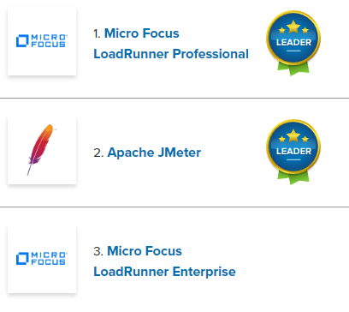
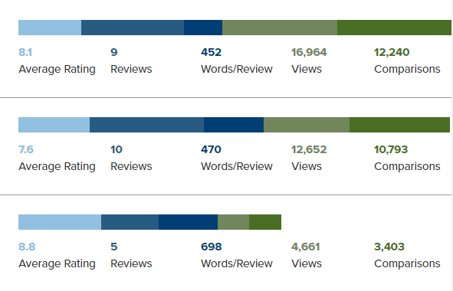
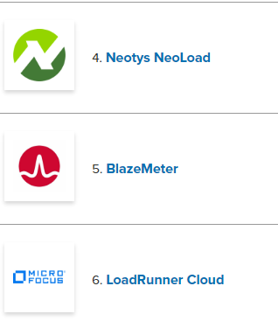
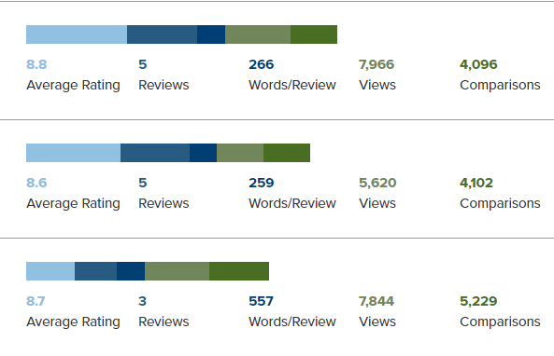
Test Tools

Slide 30
Security Testing
Topics in Testing Software
Security Testing

Slide 31

Security Testing
The goal of computer security is to protect computer assets (e.g., servers, applications, web pages, data) from:
corruption
unauthorized access
denial of authorized access
malicious software
Security is strengthened by:
physically limiting the access of computers to trusted users
hardware mechanisms (e.g., biometrics)
operating system mechanisms
anti-virus software to detect malware
secure coding techniques (e.g., array bounds checking) to make code less vulnerable to security attacks.

Slide 32
Security Testing
Approach to Software Security
Verify that security mechanisms are trustworthy
Verify that security architecture adheres to the security policy
Verify that the applications that constitute the system are trustworthy
i.e., they have been developed using secure coding practices, or they are not malware.

Slide 33
Security Testing
Security Architecture
A security architecture is a specification that is used as a guide to enforce security constraints
It specifies where security mechanisms (e.g., encryption, firewalls) need to be positioned in the software architecture
The quality of a security architecture also depends on the security of the applications that constitute the system

Slide 34
Security Testing
Security Architecture
Security architecture describes the position of security mechanisms in the software architecture and comprises:
subsystems
e.g., web servers, application servers
communication links between the subsystems
e.g., local or remote protocols (SSL, HTTPS, LDAP)
position of security mechanisms
e.g., authentication and authorization points

Slide 35
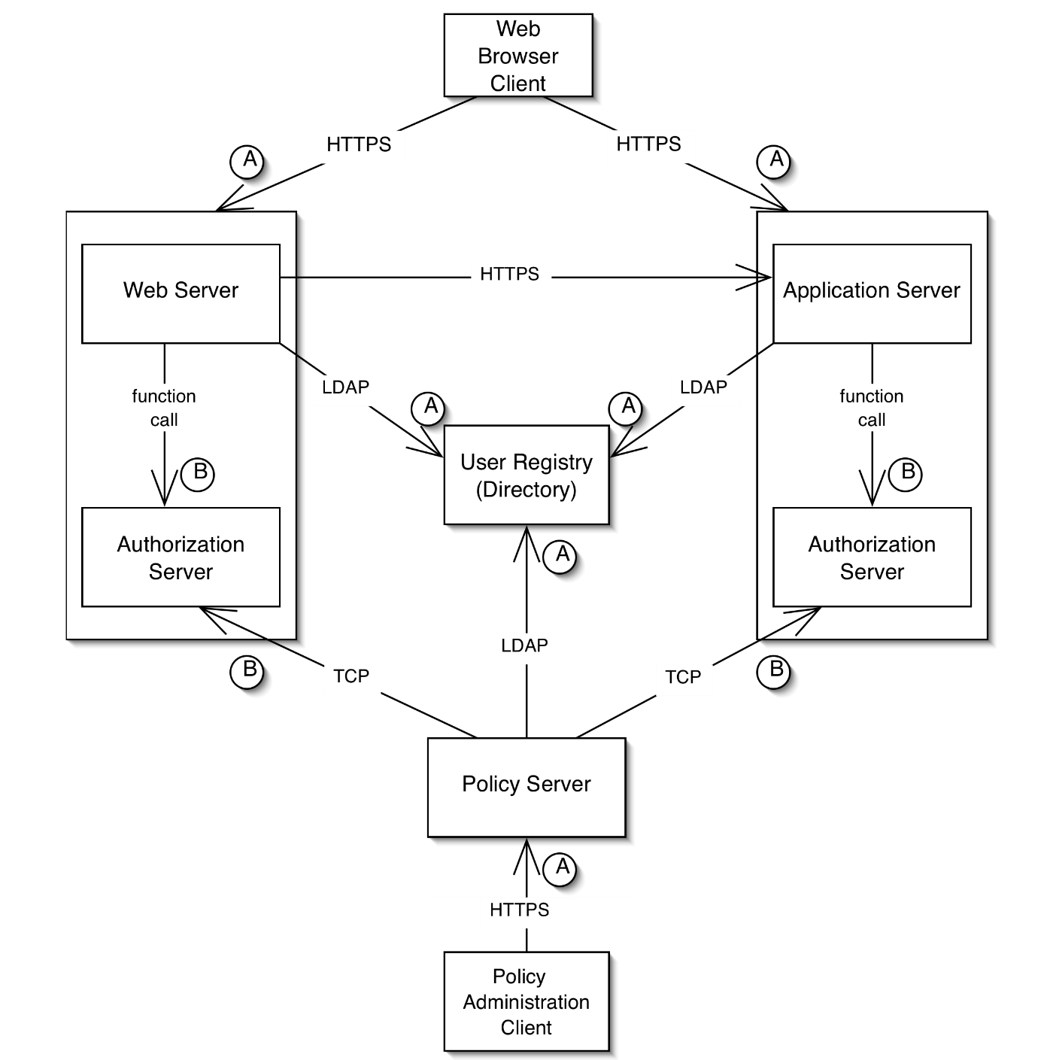
Security Testing
Example of a Security Architecture

Slide 36
Security Testing
Validating Security Architecture
There are many security faults that arise from a poorly designed security architecture, e.g.,
unauthorized access to data and applications
confidential and restricted data flowing as unencrypted text over network connections
Security architecture is validated using a process called threat modeling.
Threat modeling is typically a manual (i.e., not automated) inspection process, similar to code and requirements inspection.

Slide 37
Security Testing
Threat modeling
Threat Modeling is a process for evaluating a software system for security issues.
It is a variation of the code and specification inspections processes discussed earlier in the course.
The goal is for a review team to look for software features that vulnerable from a security perspective.
Threat modeling is not the responsibility of a software tester, although testers may be involved in the security review team.

Slide 38
Security Testing
Threat modeling process (1)
Assemble the treat modeling team
Include security experts and consultants
Identify the assets
E.g., credit card numbers, social security numbers, computing resources, trade secrets, financial data
Create an architecture overview
Define the architecture and identify the trust boundaries and authentication mechanisms
Decompose the application
E.g., identify data flows, encryption processes, password flows.

Slide 39
Security Testing
Threat modeling process (2)
Identify threats
E.g., can data be viewed, changed? Limit access of legitimate users? Unauthorized access of the system?
Document threats
E.g., describe threat, target, form of attack, counter-measures to prevent an attack, etc.
Rank threats (scale: low, medium, high)
Damage potential
E.g., property, data integrity, financial loss
Reproducibility
E.g., probability that an attempt to compromise the system will succeed
Exploitability/Discoverability
E.g., is it difficult to hack into the system?
Affected users
How many users will be affected? Who are these users? Are they important?

Slide 40
Security Testing
What is Malware?
Malware (malicious software) is any program that works against the interest of the system’s user or owner.
Question: Is a program that spies on the web browsing habits of the employees of a company considered malware?
What if the CEO authorized the installation of the spying program?

Slide 41
Security Testing
Types of Malware
Viruses
Worms
Trojan Horses
Backdoors
Mobile code
Adware

Slide 42
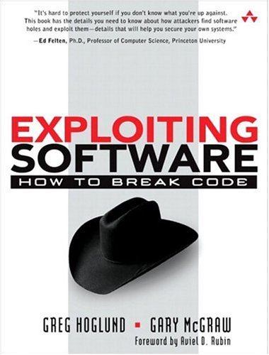
Secure Coding
Secure coding involves programming practices and run-time mechanisms that can limit the vulnerability of applications to malware.
Common malware exploits arise from coding problems:
buffer overflows
format string vulnerabilities
integer vulnerabilities
42

Slide 43
Secure Coding
Buffer overflow attacks cost the software industry hundreds of millions of dollars per year.
C/C++ code is the overwhelming target of buffer overflow, format string, and integer vulnerability attacks.
43

Slide 44
Security Testing
Software vulnerability
What are software vulnerabilities?
Types of vulnerabilities
E.g., Buffer Overflows
How to find these vulnerabilities and prevent them?
Classes of software vulnerabilities
A software vulnerability is an instance of a fault in the specification, development, or configuration of software such that its execution can violate the (implicit or explicit) security policy.

Slide 45
Security Testing
Types of software vulnerability
Buffer overflows
Smash the stack
Overflows in setuid regions
Heap overflows
Format string vulnerabilities

Slide 46
Security Testing
What is a buffer?
Example:
A place on a form to fill in last name where each character has one box.
“Buffer” is used loosely to refer to any area of memory where more than on piece of data is stored.

Slide 47
Security Testing
Buffer overflows
The most common form of security vulnerability in the past years
1998: 2 out of 5 “remote to local” attacks in Lincoln Labs Intrusion Detection Evaluation were buffer overflows.
1998: 9 out of 13 CERT advisories involved buffer overflows.
1999: at least 50% of CERT advisories involved buffer overflows.

Slide 48
Security Testing
How does a buffer overflow happen?
Reading or writing past the end of the buffer → overflow
As a result, any data that is allocated near the buffer can be read and potentially modified (overwritten)
A password flag can be modified to log in as someone else.
A return address can be overwritten so that it jumps to arbitrary code that the attacker injected (smash the stack) → attacker can control the host.

Slide 49
Security Testing
Two steps
Arrange for suitable code to be available in the program’s address space (buffer)
Inject the code
Use code that is already in the program
Overflow the buffer so that the program jumps to that code.

Slide 50
Security Testing
Inject the code
Use a string as input to the program which is then stored in a buffer.
String contains bytes that are native CPU instructions for attacked platform.
Buffer can be located on the stack, heap, or in static data area.

Slide 51
Security Testing
Buffer overflows defenses
Writing correct code (good programming practices)
Debugging Tools
Non-executable buffers
Array bounds checking
Code pointer integrity checking (e.g., StackGuard)

Slide 52
Security Testing
Problems with C
Some C functions are problematic
Static size buffers
Do not have built-in bounds checking
While loops
Read one character at a time from user input until end of line or end of file
No explicit checks for overflows

Slide 53
Security Testing
Some problematic C functions
Function | Severity | Solution: Use
gets | Most Risky | fgets(buf, size, stdin)
strcpy, strcat | Very Risky | strncpy, strncat
sprintf, vsprintf | Very Risky | snprintf, vsnprintf or precision specifiers
scanf family | Very Risky | precision specifiers or do own parsing
realpath, syslog | Very Risky (depending on implementation) | Maxpathlen and manual checks
getopt, getopt_long, getpass | Very Risky (depending on implementation) | Truncate string inputs to reasonable size

Slide 54
Security Testing
Good programming practices – I (useful to know for code inspections)
DO NOT USE: | Instead USE:
void main( ) { char buf [40]; gets(buf); } | void main( ) { char buf [40]; fgets(buf,40,stdin); }

Slide 55
Security Testing
Good programming practices – II
DO NOT USE: | Instead USE:
void main() { char buf[4]; char src[8] = "rrrrr"; strcpy(buf,src); } | if (src_size >= buf_size) { cout<< "error"; return(1); } else { strcpy(buf,src); } OR strncpy(buf,src,buf_size - 1); buf[buf_size - 1] = '\0';

Slide 56
Security Testing
Debugging tools
More advanced debugging tools
Fault injection tools – inject deliberate buffer overflow faults at random to search for vulnerabilities
Static analysis tools – detect overflows
Can only minimize the number of overflow vulnerabilities but cannot provide total assurance

Slide 57
Security Testing
Array bounds checking
Attempts to prevent overflow of code pointers
All reads and writes to arrays need to be checked to make sure they are within bounds (check most array references)
C compiler
Jones & Kelly array bound checking
Purify memory access checking
Type-safe languages (e.g., Java)

Slide 58
Security Testing
Research Challenges
Formal Security Architectures
“The software maintenance community is challenged to investigate the creation of a suite of tools to model and simulate the behavior of security architectures as well as support the verification of properties that are relevant to security”
Security Attack Diagnosis and Mitigation
“The software maintenance community is challenged to investigate techniques that will enable software to self-diagnose security attacks and self-mitigate the effects of these attacks at run-time”

Slide 59
To be continued… See you next week

